Slide 1


CS7GV5 Real-time Animation
Interactive Game with Animated Characters
GUIDED BY:
Miss Dr. Rachel Mc Donnell
Work Completed by:
Yuzhou Shao (Student number 19322035 ARVR)

Slide 2
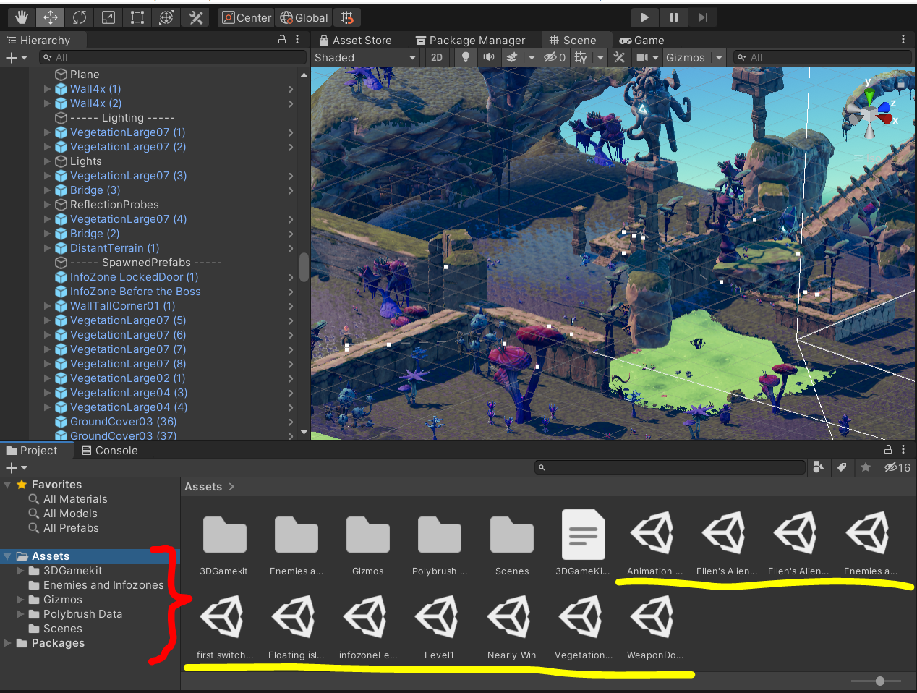
Introduction
The project is developed by Unity which is a higher-level Graphics engine.
Some Codes are programmed through Visual Studio C++ and C#.
On the right screenshot. The assets indicated by the red curly braces, were imported from the asset store.
The scenes underlined by the yellow line, along with their hierarchies(totally 46GB ), are developed by myself.
Here, I selected the scene named Ellen’s Alien Adventure Final as the sample to introduce my work.

Slide 3
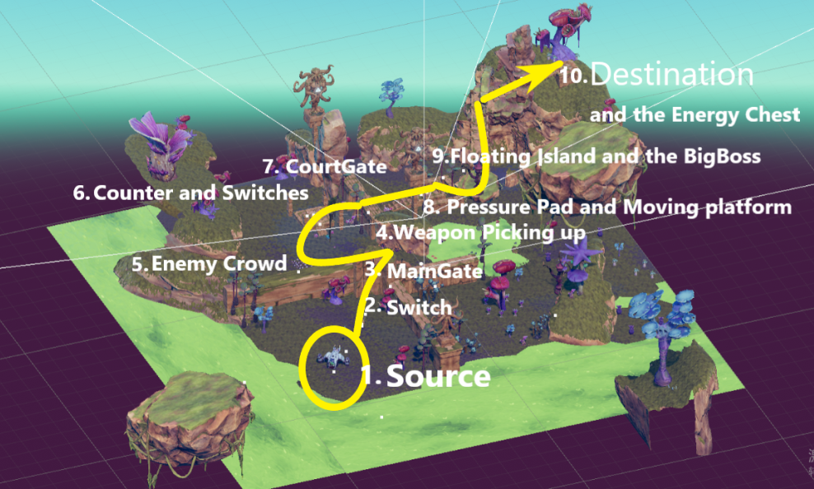
Overall Scene and Scenario Explanation
The Protagonist named Ellen, was abounded in an alien island(See right map).
Ellen needs to find the Energy Chest to get her dropped spaceship repaired.
To reach the Destination from the Source, Ellen will come over the important points on the right.

Slide 4
features of The game
(The first Six Features will be Explained in detailed)
Switching Gate
Weapon Picking Up
Infozones
Enemies
Energy Chest with Win Triggering
Checkpoints
Crowd of Enemies
Moving Platform and Pressure Pad

Slide 5
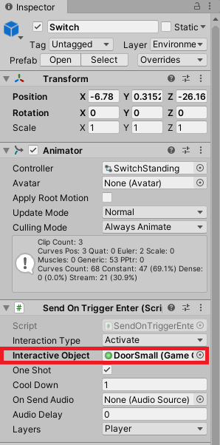
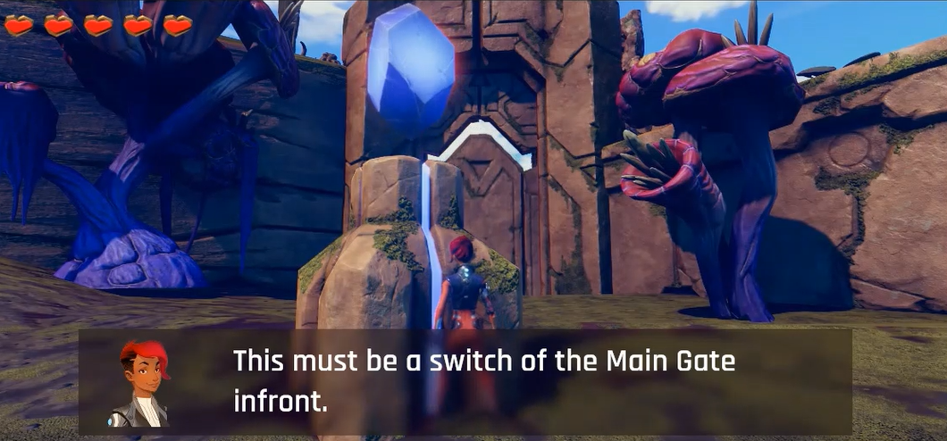
Switches and Gates
The Switch is linked to the Gate.
Once the protagonist walks close to the switch, the linked gate will be open automatically.
The left image briefly shows how those two are linked. And below image displays its scene.

Slide 6
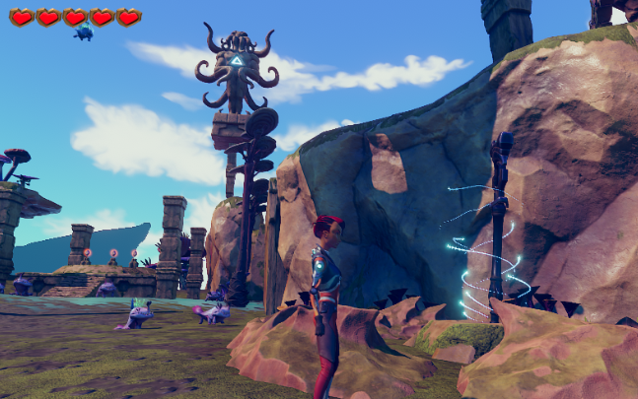
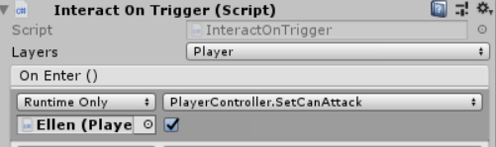
Weapon Picking Up
The protagonist Ellen can attack enemies once she picks up the weapon.
To implement this:
First, can attack option from the Hierarchy Ellen should be deactivated.
Second, in the child object of weapon named StaffTakeTrigger, the function named
PlayerController.SetCanAttack should be enabled.
The Screenshot above is taken while Ellen is going to pick up the weapon.

Slide 7
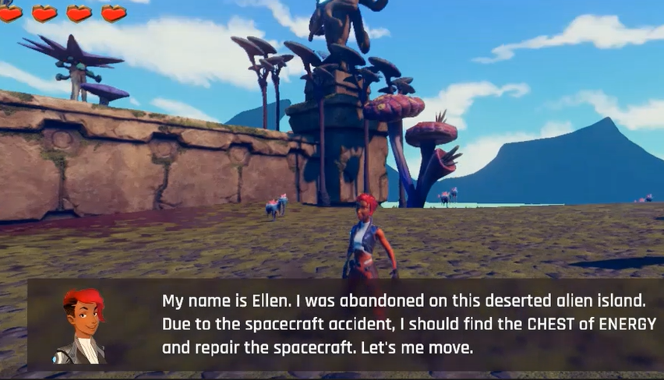

Infozones
The Screenshot of the Infozones after playing
It is used to give the user a hint base on the scenario and tell the importance when Ellen reach to a specific position.
This is most commonly done via dialogue from the protagonist to the player.
To implement it, set On Enter (Object) and On Exit to the Dialogue Canvas Controller Script by dragging it into the empty object slot.

Slide 8


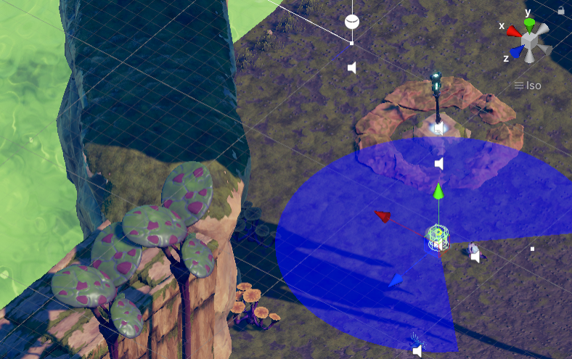
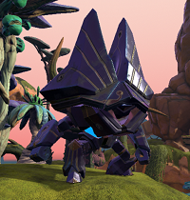
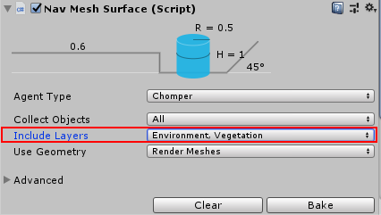
Enemies
The detecting radius should be set so that the enemies can detect Ellen once she reaches inside the range.
Then, a function called Nav Mesh Surface from the plane of the hierarchy should be configurated to tell the enemies that they can walk within which areas of the scene.
Different types of enemies from the scene

Slide 9
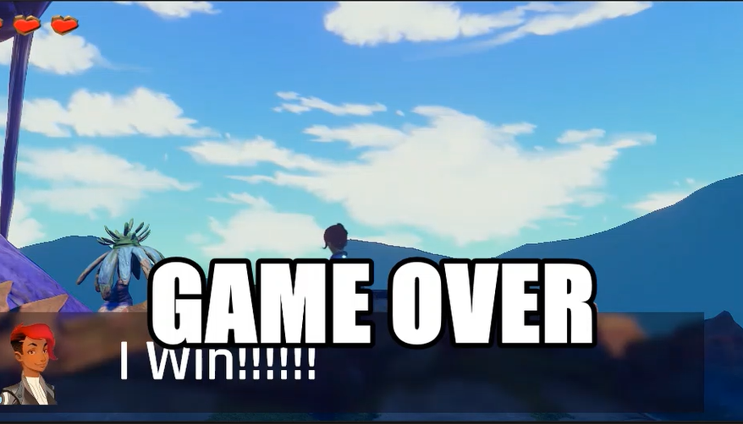
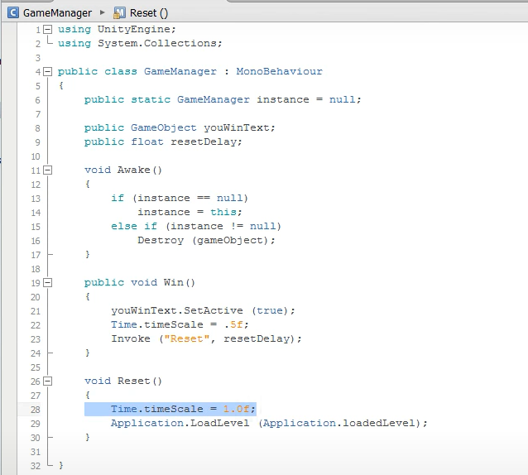
Energy Chest with Win Triggering
To implement Win, I created an empty object named GameManager and coded as below, to trigger I Win!!!!!! showing on the game.
Slow down the time, and reset the game. Then I had linked GameManager to the target 3D object on the game which triggers a win scenario.
The Screenshot of the While Winning
Game Losing is also implemented by this similar concept.

Slide 10
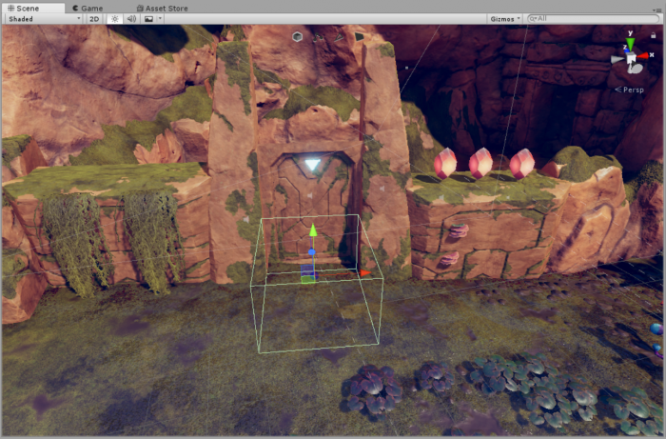
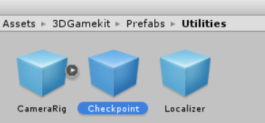
Checkpoints
Checkpoints ensure that when the protagonist dies, she will be respawned at the last checkpoint she touched.
The Screenshot of a Checkpoint

Slide 11
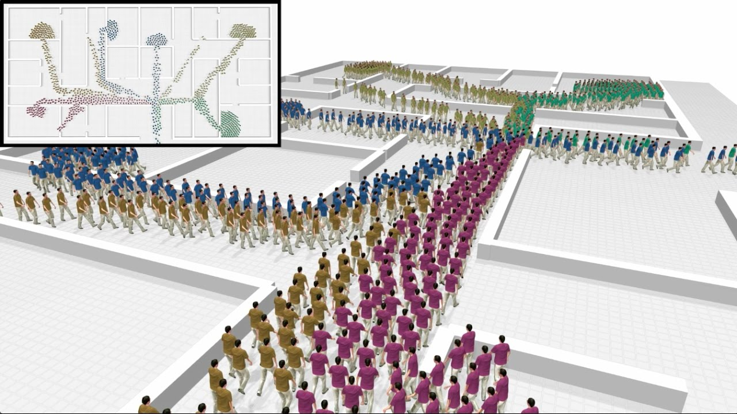
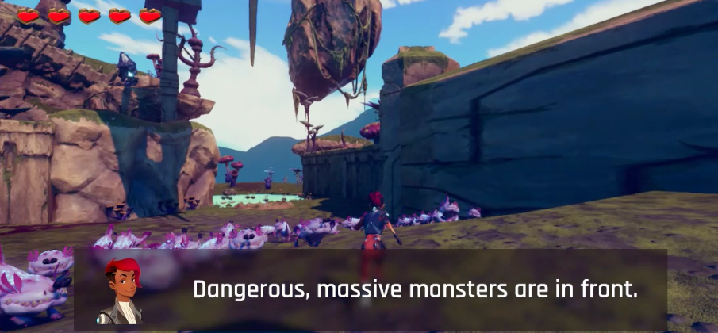
Crowd Simulation
Crowd simulation is the process of simulating the movement of a large number of entities or characters.
It is commonly used to create virtual scenes for visual media like films and video games, and is also used in crisis training, architecture and urban planning, and evacuation simulation.

Slide 12
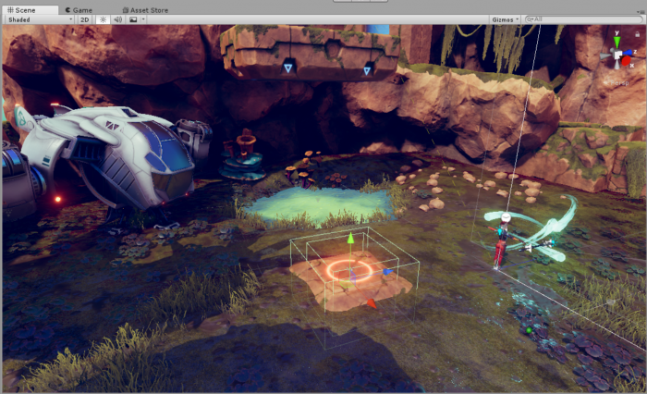
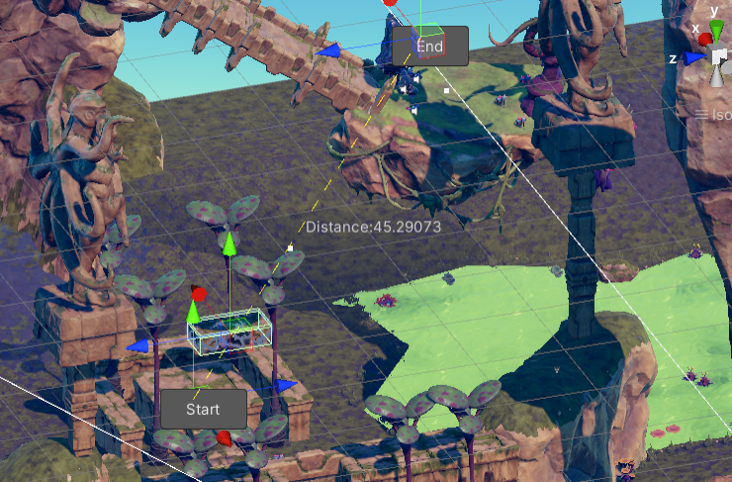
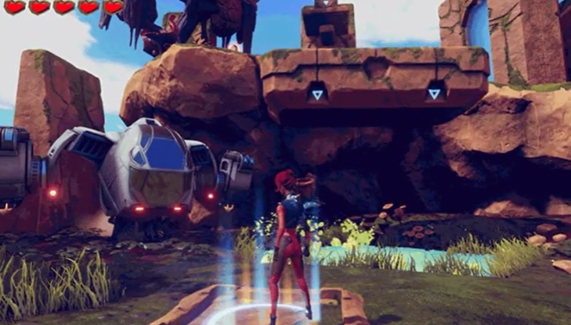
Moving Platform Triggered by A Pressure pad

Slide 13
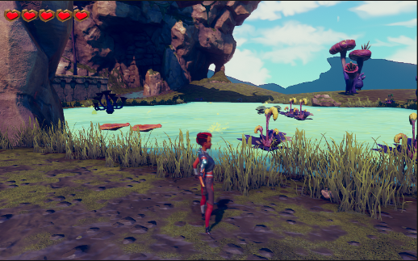
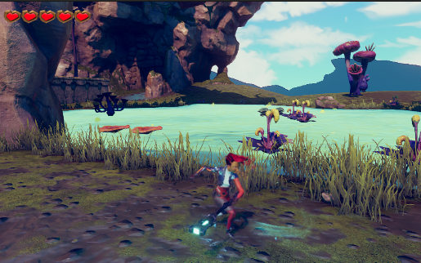
Interesting Facial Screenshots

Slide 14
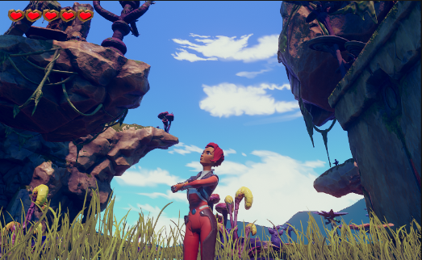
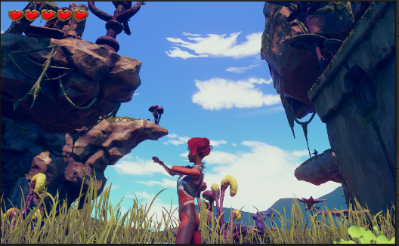
Interesting Facial Screenshots

Slide 15
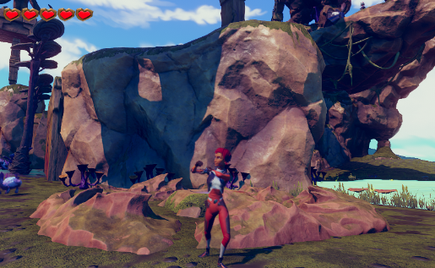
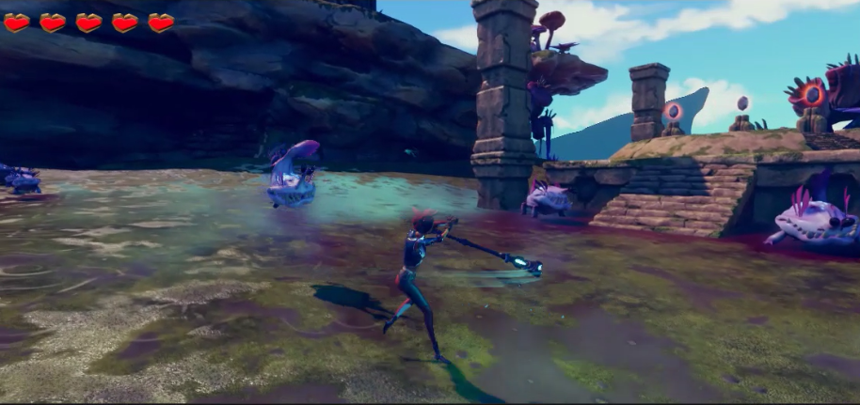
Interesting Facial Screenshots

Slide 16
Referenced resources:
Math for 3D Graphics:
Points and Vectors
Geometric Transformations
(from TCD blackboard)
MotionCapture_Lecture2-Miss Dr. Racheal
https://tcd.cloud.panopto.eu/Panopto/Pages/Sessions/List.aspx#folderID=%226b4eb516-5364-4735-b880-ab88008cbf49%22
The Explorer: 3D Game Kit
https://learn.unity.com/project/3d-game-kit?uv=2018.1
https://learn.unity.com/tutorial/quick-start?uv=2018.1&projectId=5c514897edbc2a001fd5bdd0
https://learn.unity.com/tutorial/3d-game-kit-walkthrough?uv=2018.1&projectId=5c514897edbc2a001fd5bdd0

Slide 17
Referenced resources:
https://learn.unity.com/tutorial/3d-game-kit-reference-guide?uv=2018.1&projectId=5c514897edbc2a001fd5bdd0
Unity C# Tutorials
https://www.youtube.com/watch?v=1yVxdEZvQWo&t=4s
FPS: Microgame
https://learn.unity.com/project/fps-template
Creating Basic Editor Tools
https://learn.unity.com/tutorial/creating-basic-editor-tools#5cf6c8f2edbc2a160a8a0951
Researching Human Locomotion
https://www.youtube.com/watch?v=3K0gmSgOJiw#t=98
Thalmann, Daniel (2016). "Crowd Simulation". Encyclopedia of Computer Graphics and Games. pp. 1–8. doi:10.1007/978-3-319-08234-9_69-1. ISBN 978-3-319-08234-9.

